Slide 1


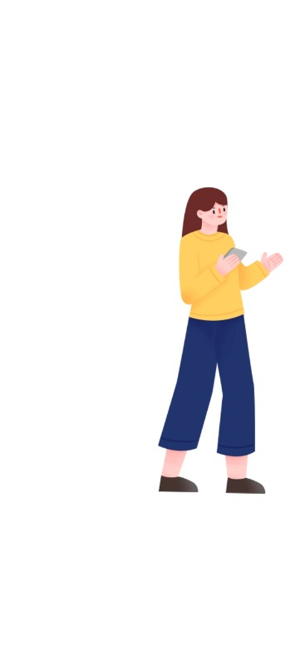







Chinese Tones

Slide 2







Introduction to Chinese Language
Pinyin
Tones
Nǐ hǎo
Pinyin
Finals
(vowels)
Pinyin
Initials
(consonants)
你 好
Chinese
Characters
you
good
With 4 elements

Slide 3

The first tone
Introduction to
Pinyin tones

Slide 4






The first tone
5
4
ā
3
2
1

Slide 5
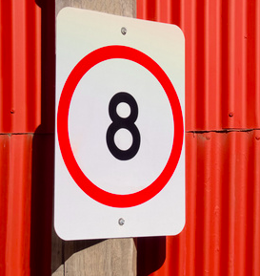
Let’s read
bā
八 eight

Slide 6
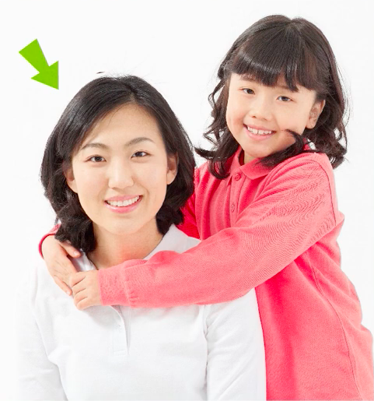
Use them in words
mā
妈 mother

Slide 7
The second tone
Introduction to
Pinyin tones

Slide 8
The second tone
5
4
á
3
2
1

Slide 9
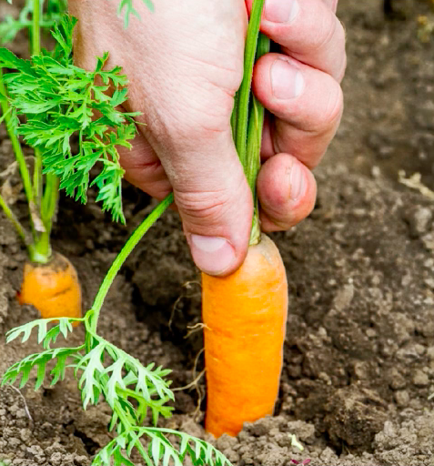
Use them in words
bá
拔 pull

Slide 10
The third tone
Introduction to
Pinyin tones

Slide 11
The third tone
5
4
ǎ
3
2
1

Slide 12
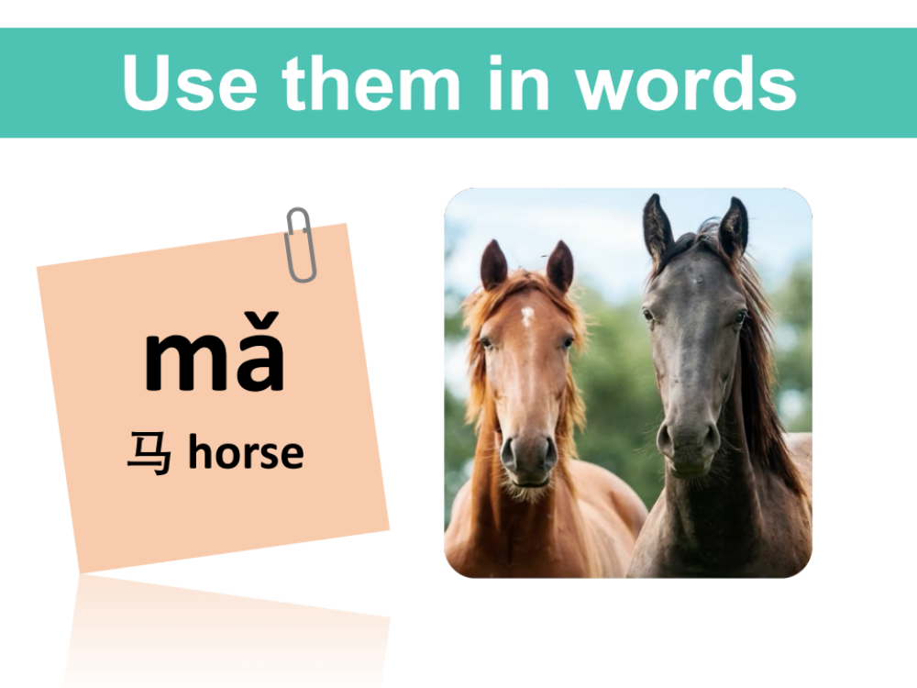
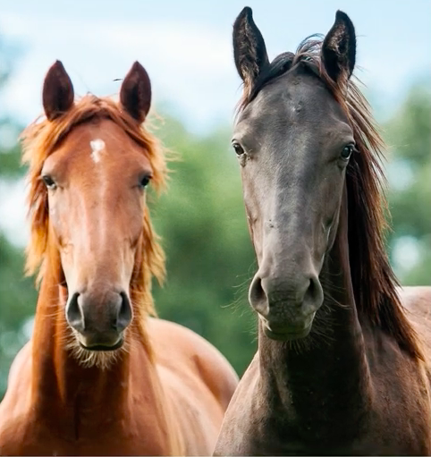
Use them in words
mǎ
马 horse

Slide 13
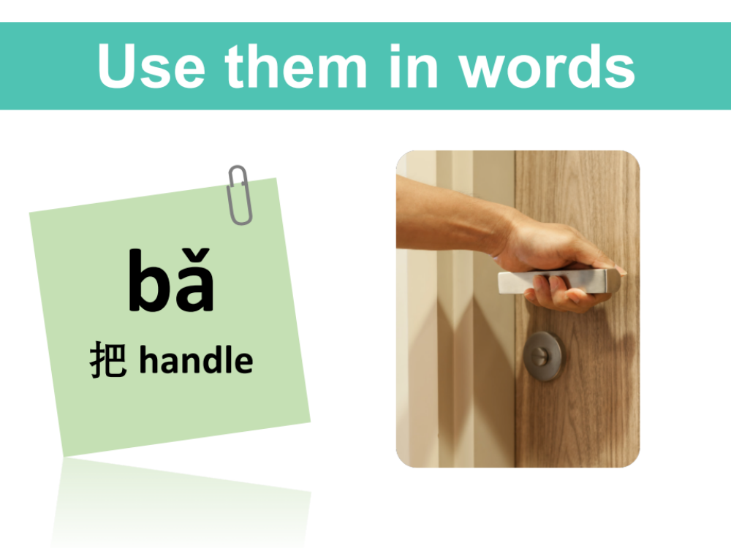
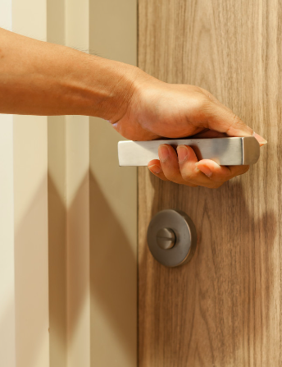
Use them in words
bǎ
把 handle

Slide 14

The fourth tone
Introduction to
Pinyin tones

Slide 15
Let’s read
5
Chinese
Characters
4
à
3
2
1

Slide 16
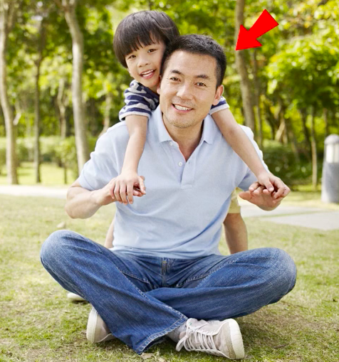
Use them in words
bà
爸 dad

Slide 17
The neutral tone
Introduction to
Pinyin tones

Slide 18
The neutral tone
5
4
a
3
2
1

Slide 19
Use them in words
māma
妈妈 mother

Slide 20
Use them in words
bàba
爸爸 dad

Slide 21

zài jiàn！
再见！

